Slide 1
Monqez
Supervised by
Dr. Mohamed El-Ramly, TA. Sarah El-Nady
Hussien Ashraf Abdul-Hamid | 20170093
Ehab Fawzy Ibrahim | 20170072
Hatem Mamdoh Saed | 20170085
Khaled Ezzat Ahmed | 20170098
Graduation Project Academic Year 2020-2021 Midyear Presentation

Slide 2
01
Introduction

Slide 3
Background
Several people die when involved in an accident because of the absence of first aid in crucial time.
Monqez is a mobile application that, among other features, allows a video or voice call with a qualified paramedic or requests a nearby specialist to help onsite and provide the needed first aid.
The project’s domain is software engineering.

Slide 4

Motivation

Slide 5
01
150,000 deaths a year could have been saved if the right first aid was applied.
02
59% of deaths that occurred before arriving to the hospital could have been saved.

Slide 6
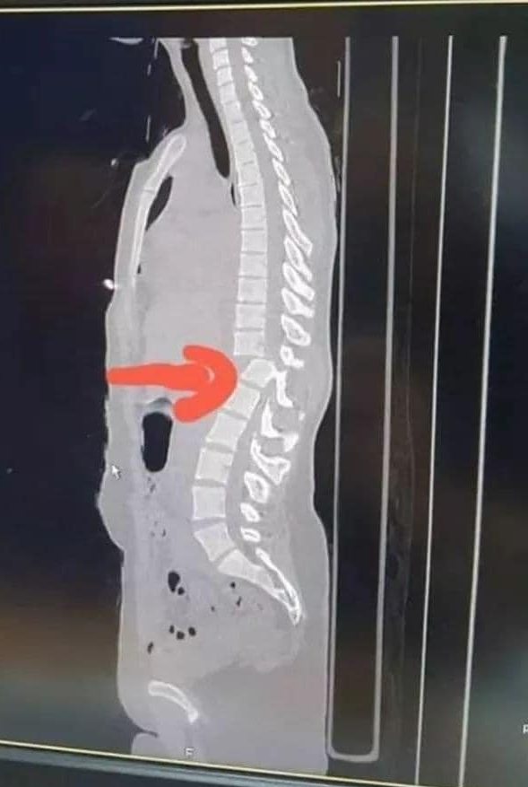
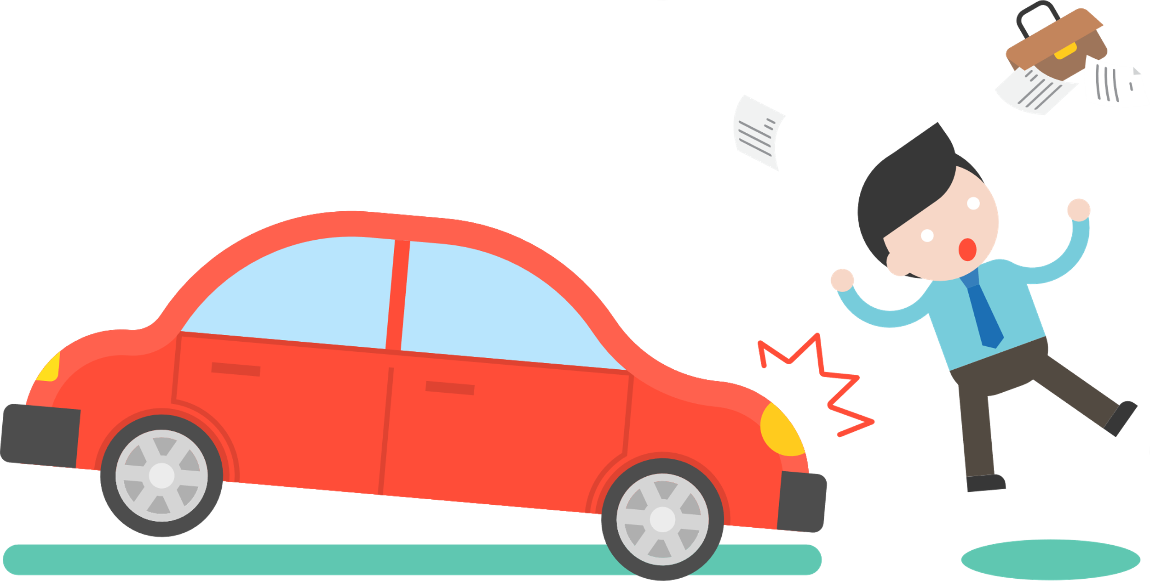
03
A 27-year-old girl had an accident. Everyone around got the girl to sit on a chair. This simple action resulted in cut in the spinal cord as the attached picture shows making this girl paralyzed for the rest of her life.

Slide 7
Problem Definition
Accidents occur every day all around the world.
93% of people will call for an ambulance if they find someone in need but ambulance may arrive late.
How can we help people who just witnessed an accident save victim’s life?
A fast and easy method is needed to connect people with paramedics at emergencies either onsite or via voice or video call.

Slide 8
Suggested Solution
A mobile application is being developed to provide help to people in need of medical assistance until an ambulance arrives.
The application connects the user requesting help to the nearest available paramedic.
The application provides basic first aid tips either through pictures or videos.
All registered paramedics must be certified and need to have passed a first aid course from accredited institutions.

Slide 9
06
Gantt Chart

Slide 10
October
November
December
January
Sprint 1
Brainstorming
SRS
Sprint 2
Sign in
Sign up
Sprint 3
Normal User Home Screen
Admin User Home Screen
Sprint 4
Helper User Home Screen

Slide 11
January
February
March
April
Sprint 5
Documentation
Deploy server on Heroku
Sprint 6
Finish Monqez Request
Sprint 7
Voice Calls
Video Calls
Sprint 8
Instructions
Ratings & Complaints

Slide 12
May
June
July
Sprint 9
One Time Request
Chatbot
Sprint 10
Testing
Bug Fixes
Sprint 11
Finalize the Project
Documentation

Slide 13
04
Tools

Slide 14
Used Tools
Node.js: It is an open source, cross-platform runtime environment for developing server-side and networking applications
Dart Programming Language: Dart is a client-optimized programming language for apps on multiple platforms such as mobile, desktop, server, and web applications
Flutter: It is a free and open-source mobile UI framework created by Google and released in May 2017. In a nutshell, it allows us to create a native mobile application with only one codebase.
Firebase: It is a Backend-as-a-Service (BaaS) by Google that provides developers with a variety of tools and services to help them develop quality apps. Firebase is categorized as a NoSQL database program, which stores data in JSON-like documents.

Slide 15
Used Tools
Google Maps Platform: It is a set of APIs and SDKs that allows developers to embed Google Maps into their mobile apps and web pages, or to retrieve data from Google Maps.
Agora Platform: It is a platform as a service which enables a wide range of real-time engagement possibilities. It has voice and video calls SDK which lets you integrate high-quality, stutter-free interactive voice chat into your app.
Dialogflow: It is a natural language understanding platform by Google used to design and integrate a conversational user interface into mobile apps, web applications, devices, bots, interactive voice response systems and related uses. It uses rule-based grammar matching as well as machine learning matching.
Postman: It is a collaboration platform for API development. Postman’s features simplify each step of building an API and streamline collaboration so you can create better APIs – faster.

Slide 16

02
Related Works

Slide 17
New Zealand Red Cross First Aid
Web application that provides courses and step by step instructions for a variety of emergencies.
Doesn’t send a paramedic to help the victim.
It relies on normal users to understand and follow the first aid instructions shown

Slide 18
PulsePoint Respond
Informs users of emergencies in their community and can request their help when CPR is needed nearby.
Mostly concentrates on cardiac attack.
People sent to help victims aren’t necessarily paramedics.
No voice or video call are provided.

Slide 19
Asifny
Asifny sends a distress call by SMS service to Saudi Red Crescent Authority and relatives.
This application sends an ambulance - not a nearby person with a first aid certificate - to the patient in order to save his life.
This makes the process of reaching the patient slower.

Slide 20
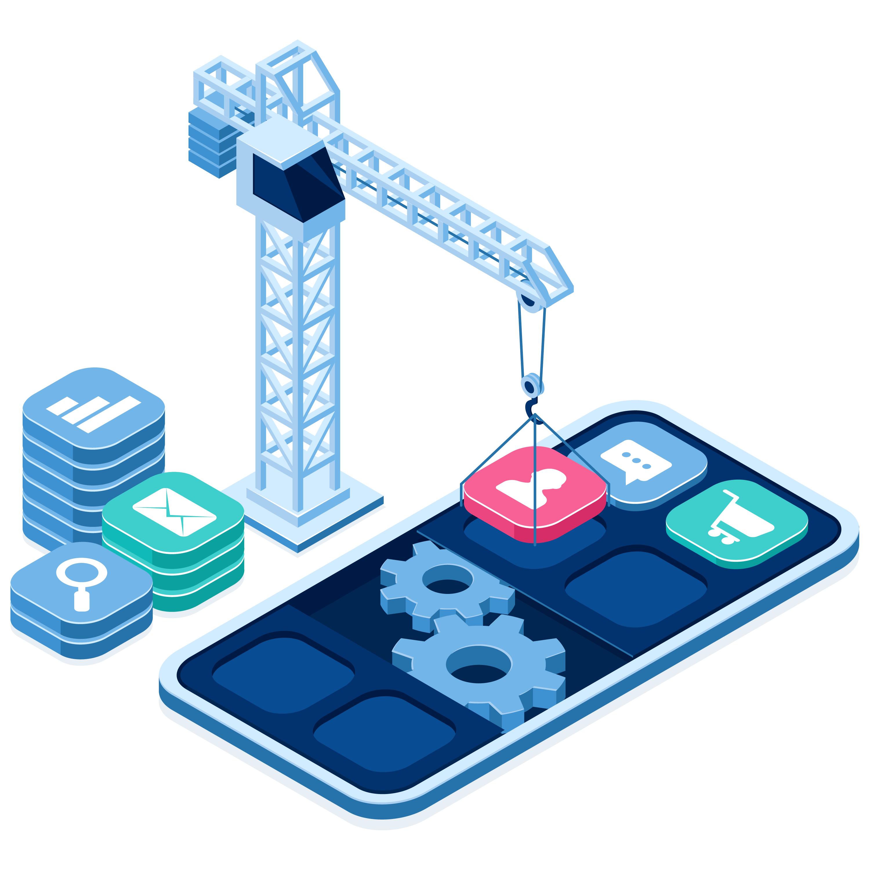
03
System Analysis

Slide 21
Functional Requirements
Show the first aid instructions for any type of injury.
Allow the normal user to request a Monqez for himself or for someone else in need of first aid.
Connect the normal user to a Monqez so that the Monqez shall arrive to the emergency site.
Provide video and voice calls between a normal user and any available Monqez.
Show the Monqez applications and their certificates to administrators.
Add points to a Monqez when he completes a request. These points can be redeemed when a sponsor provides pointing system.

Slide 22

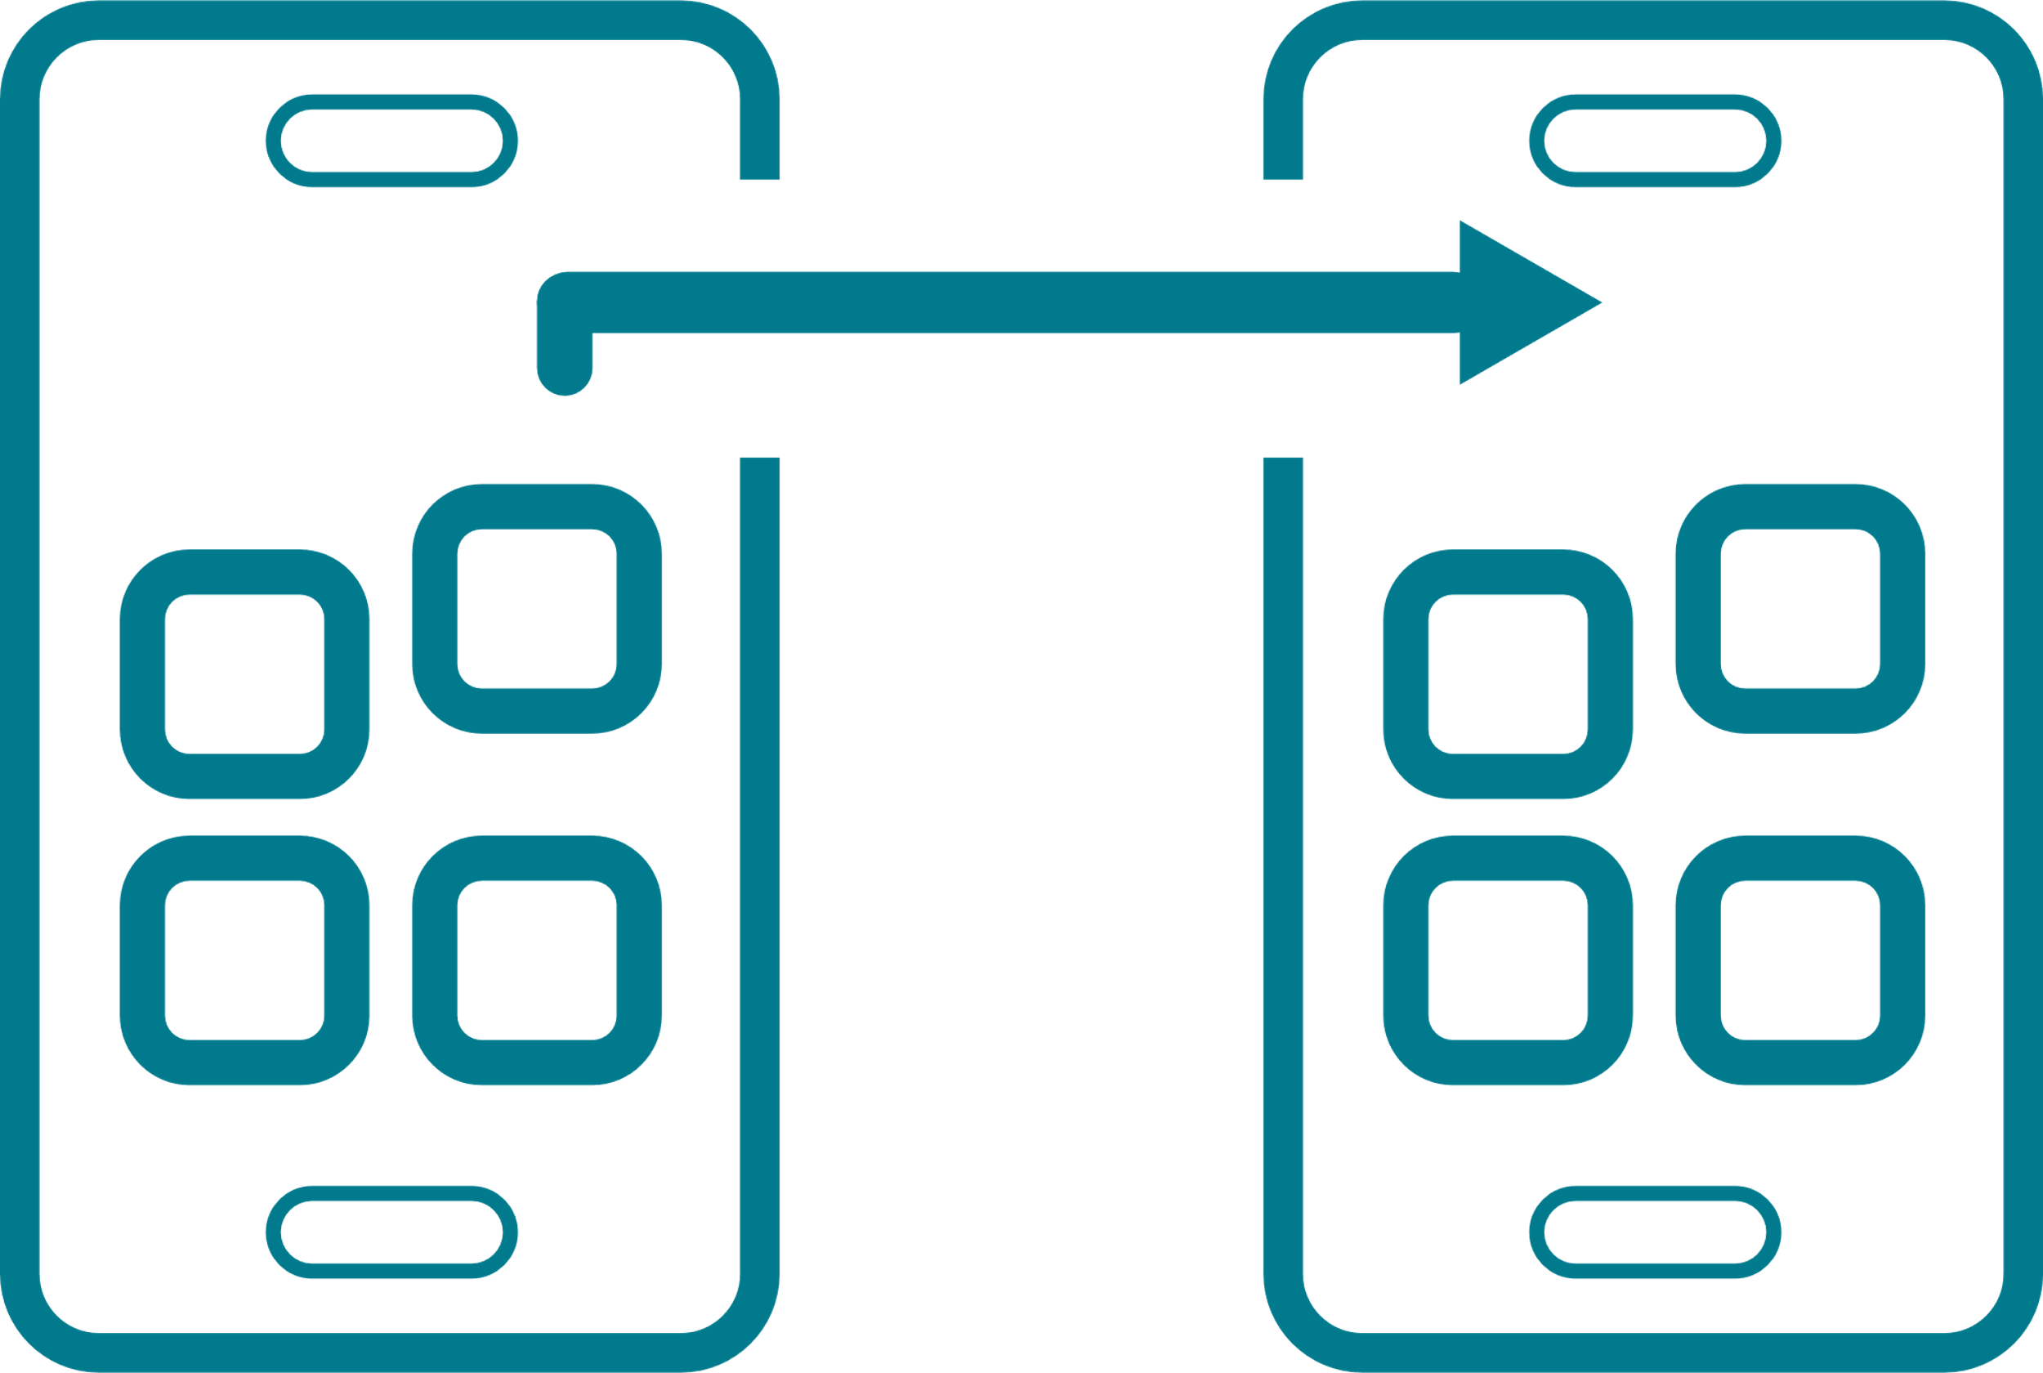



Non-functional Requirements
Performance
Portability
Reliability
Minimal searching time for nearby Monqez.
Application works on different OS.
Work with full functionality in worst cases.
Usability
Robustness
Application is very easy to use (user-friendly).
Application handles invalid user input.

Slide 23
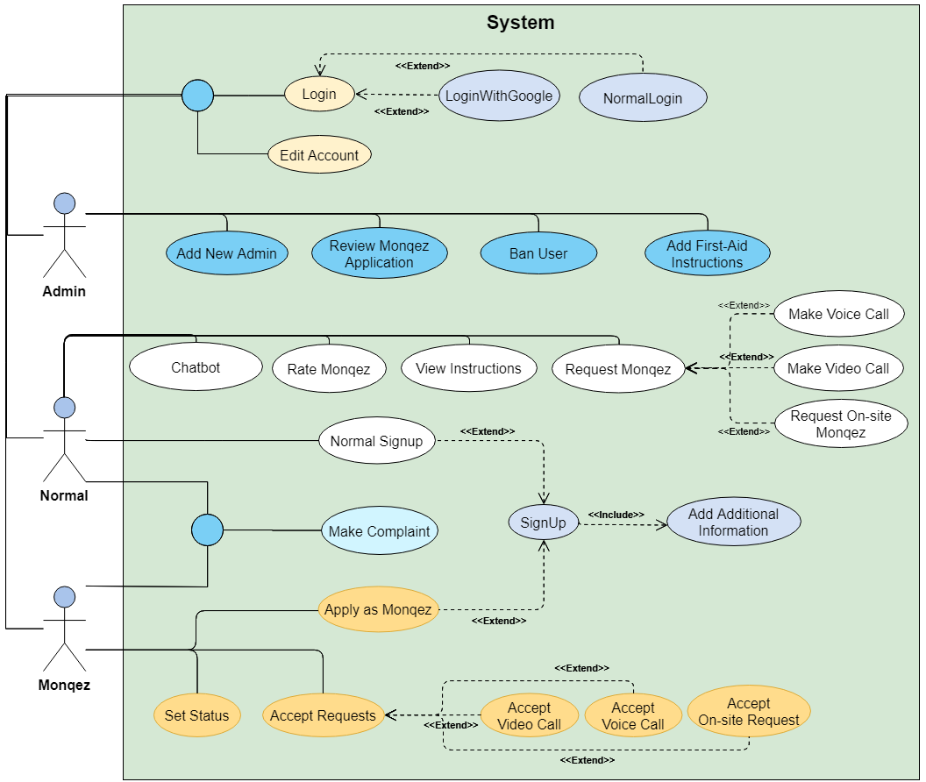
Use case Diagram

Slide 24
Sample Use Case
Use Case Name | Signup.
Brief Description | User creates a new account in the system.
Actors | Normal user, Helper (Monqez).
Preconditions | No account exists for the user in the database.
Postconditions | A new account is added to the database with the user information.
Main Scenario | System displays the signup page. User enters the credentials (email and password). System stores the credentials. System redirects the user to the “Add Additional Information” page.
Exception Flow | System displays an error message. System displays the signup page.

Slide 25
Sample Use Case
Use Case Name: | Request onsite Monqez
Brief Description: | Normal user requests helper on site.
Actors: | Normal user
Preconditions: | User is logged in.
Postconditions: | The request is added to the database. System notifies the nearest 3 helpers.
Main Scenario: | Normal user presses the “Get Help” button. System shows “Add Additional Information” pop-up. Normal user fills the request’s additional information and presses “Submit”. System notifies the nearest 3 helpers.
Alternative Scenario: | Normal user presses the “Get Help” button. System finds that no available Monqez is near the normal user. System informs the normal user that no available Monqez exists at the moment.

Slide 26
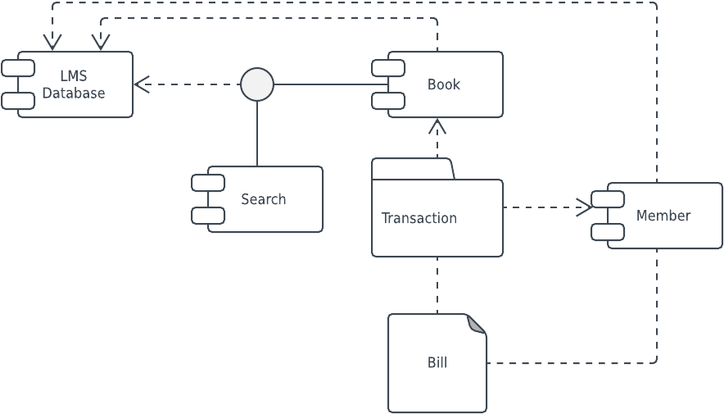
05
System Design

Slide 27
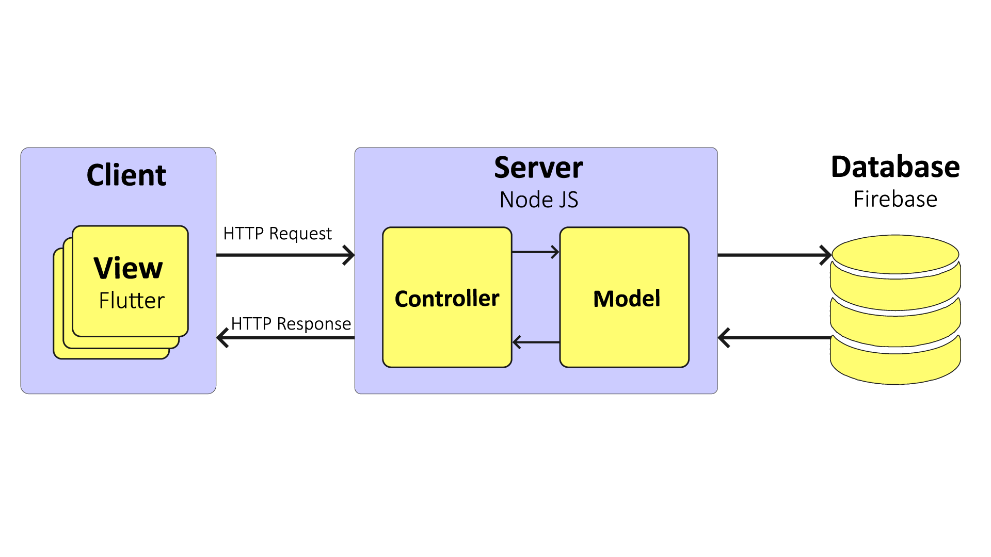
System Architecture

Slide 28
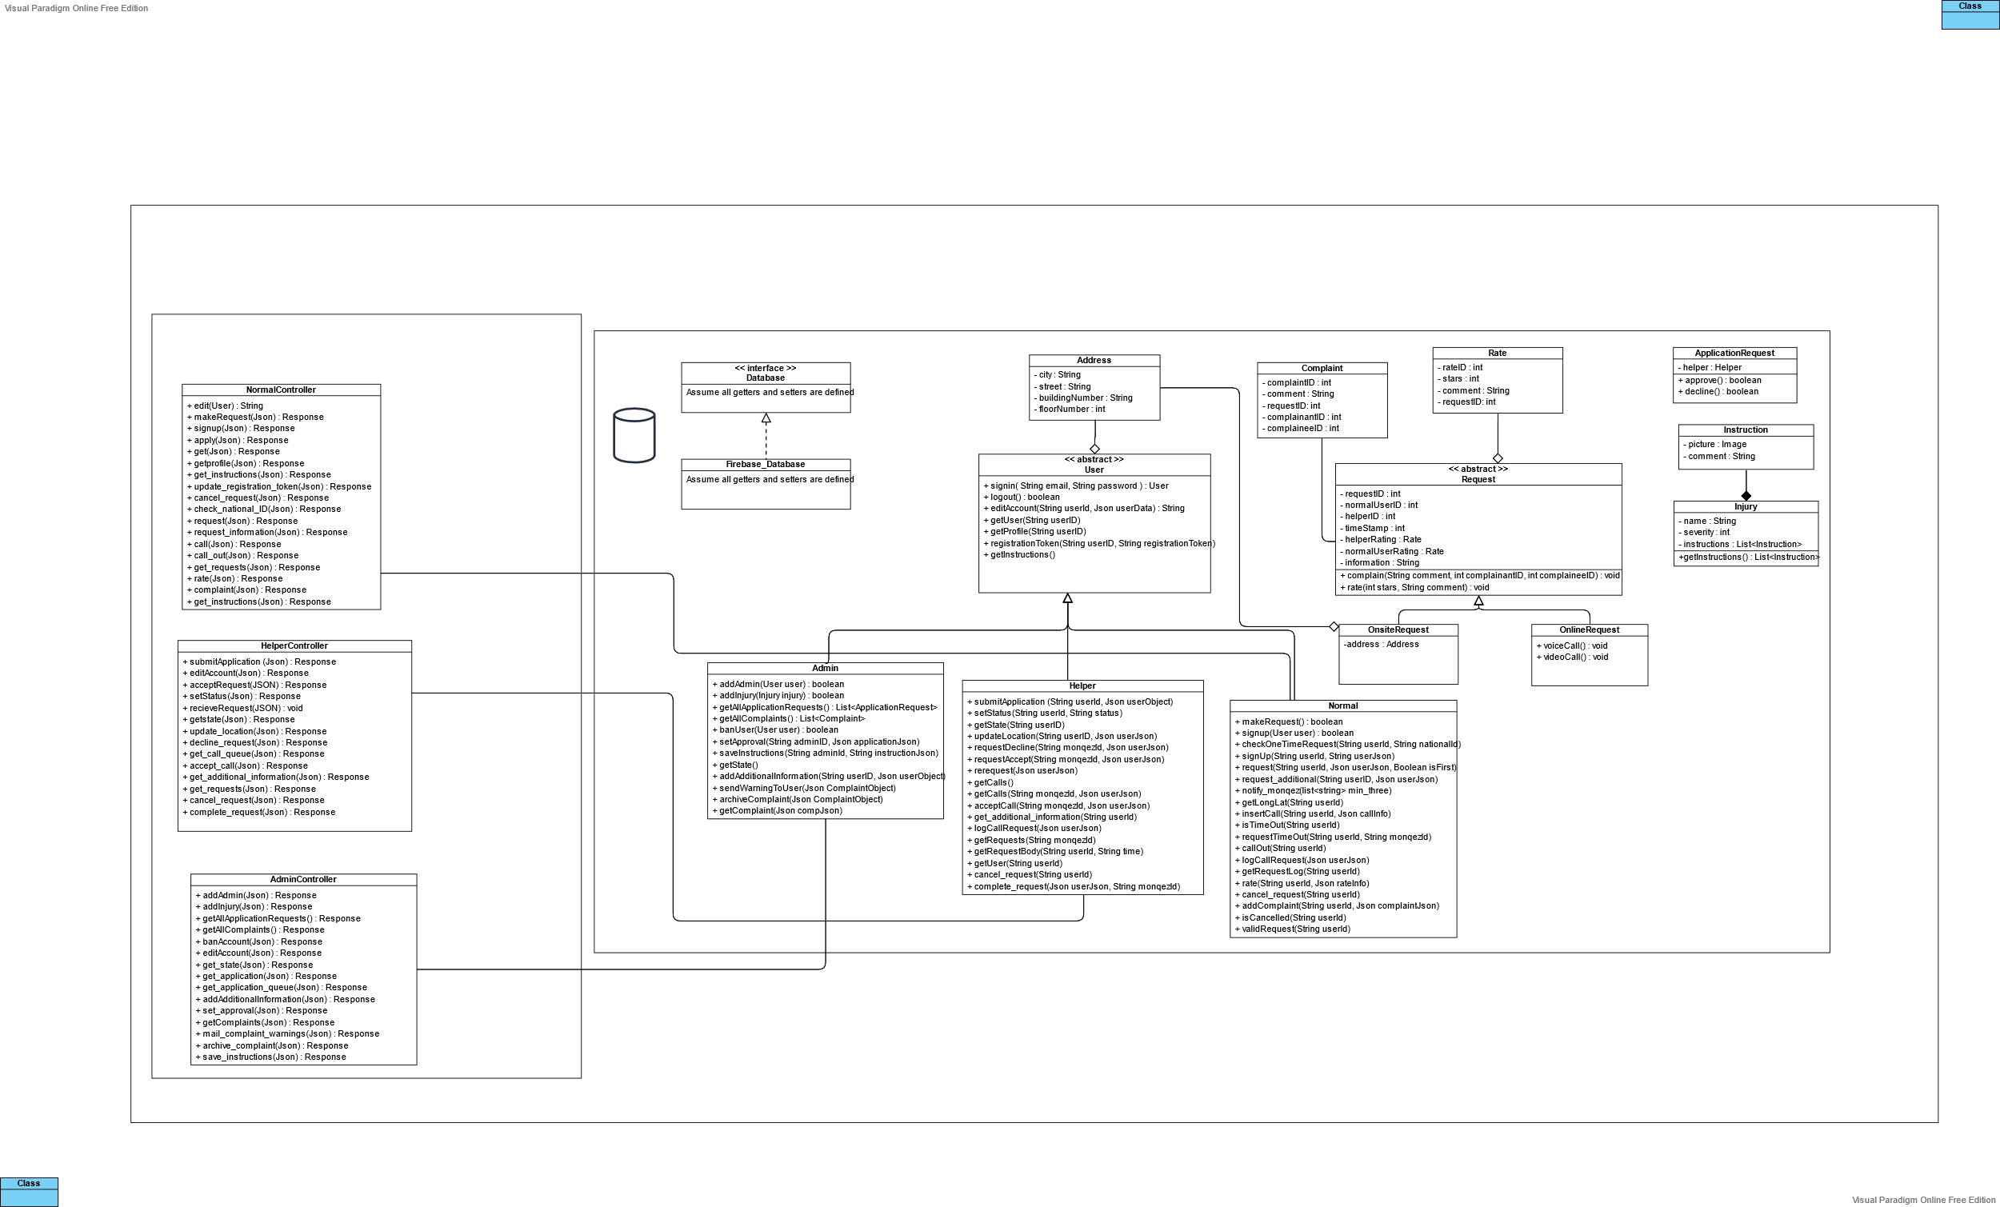
Class Diagram
Database
Assume all models calling Firebase_Database

Slide 29
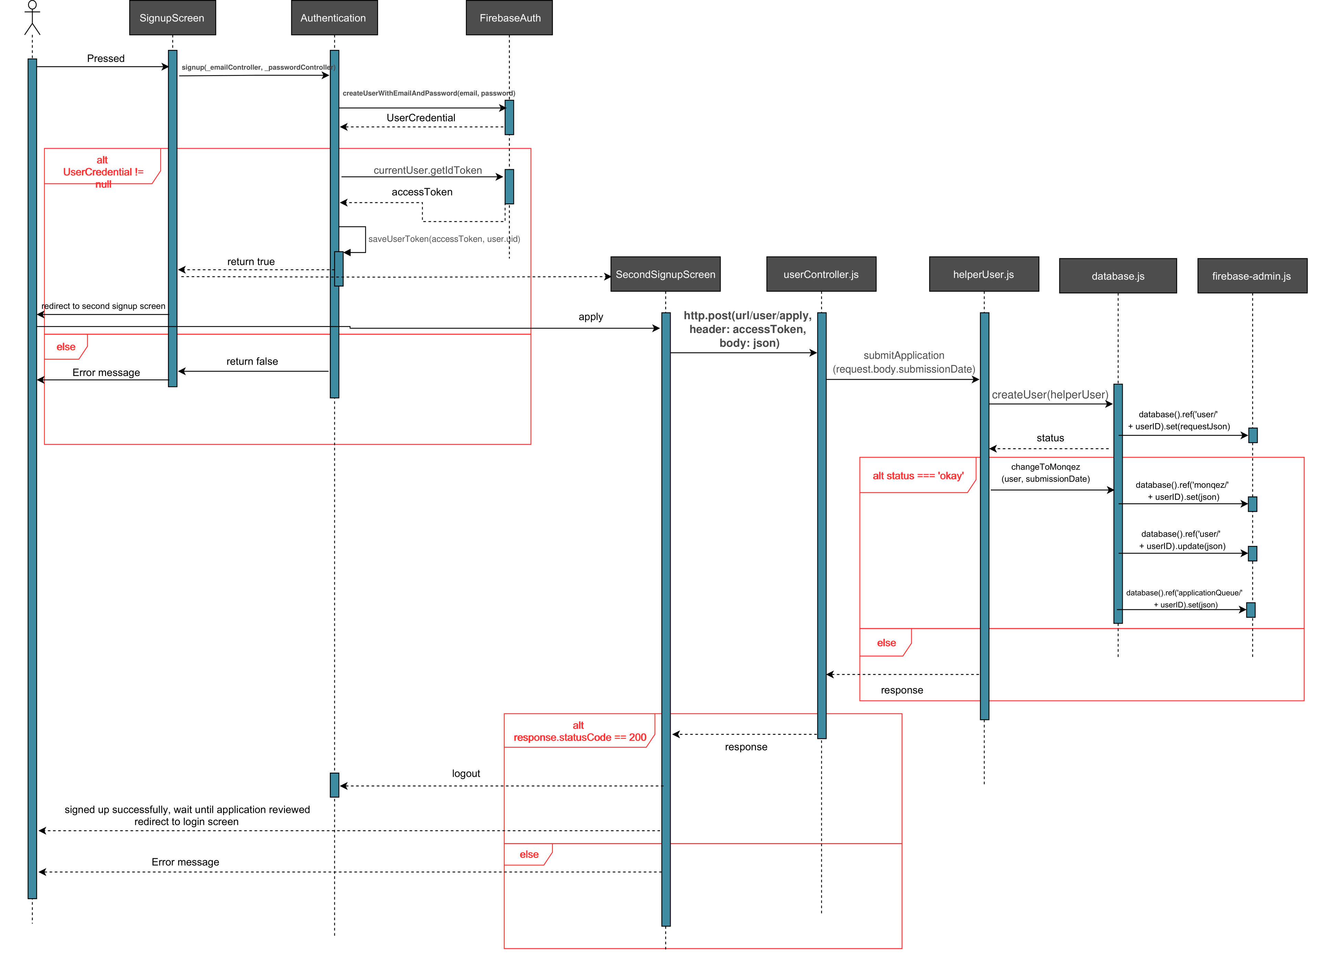
Sequence Diagram
Apply as Monqez

Slide 30
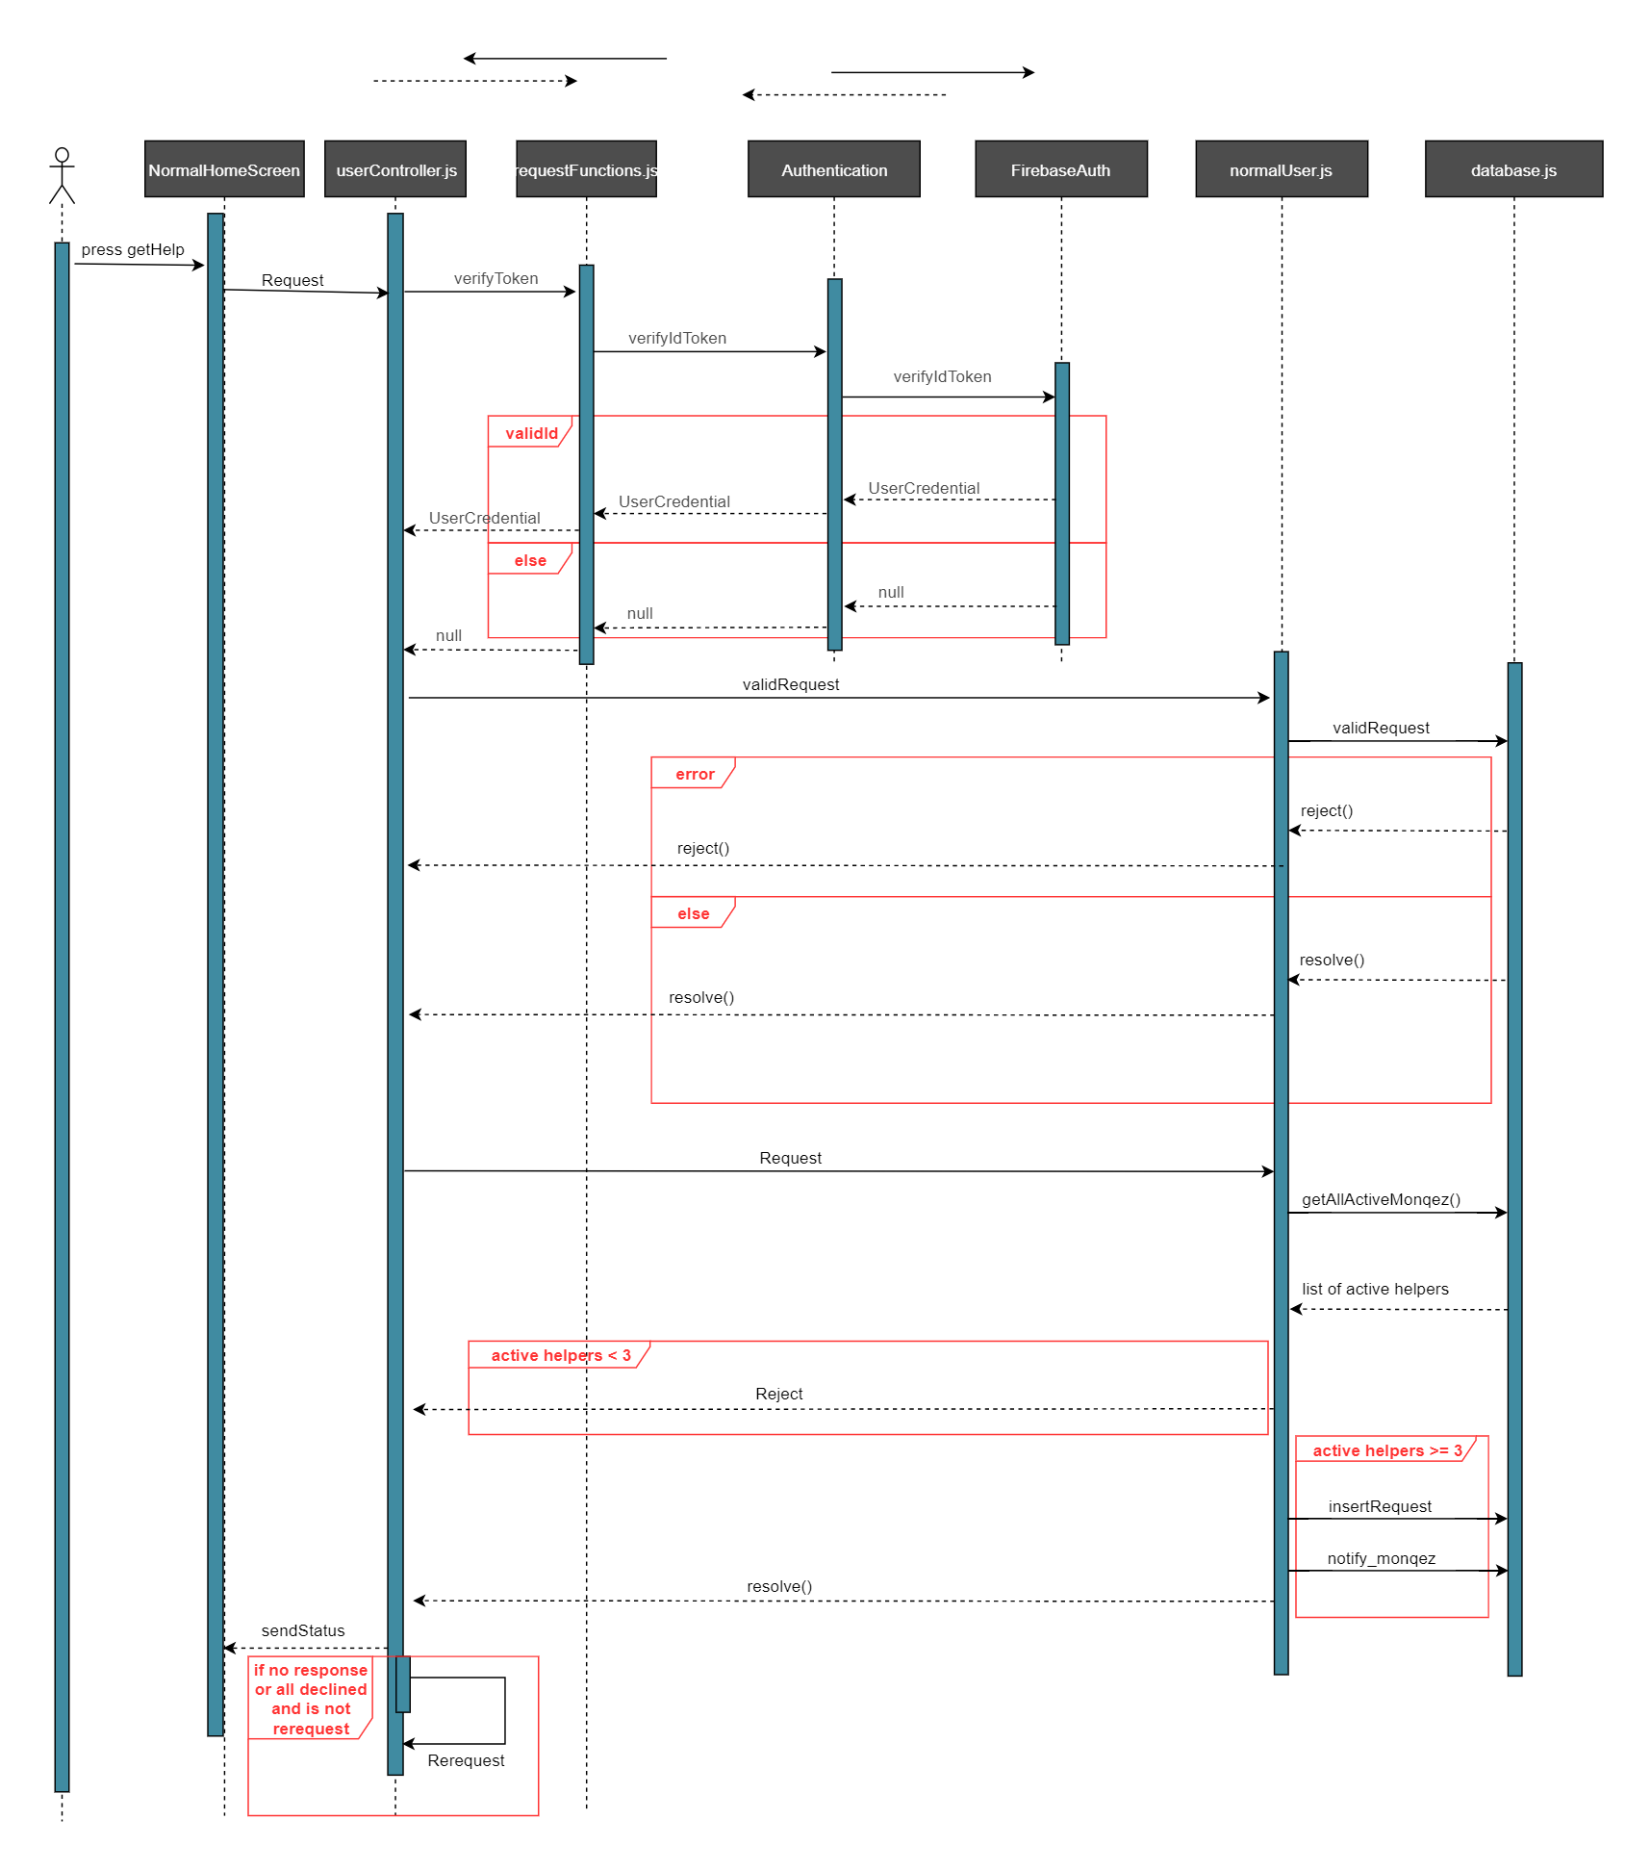
Sequence Diagram
Request Monqez

Slide 31
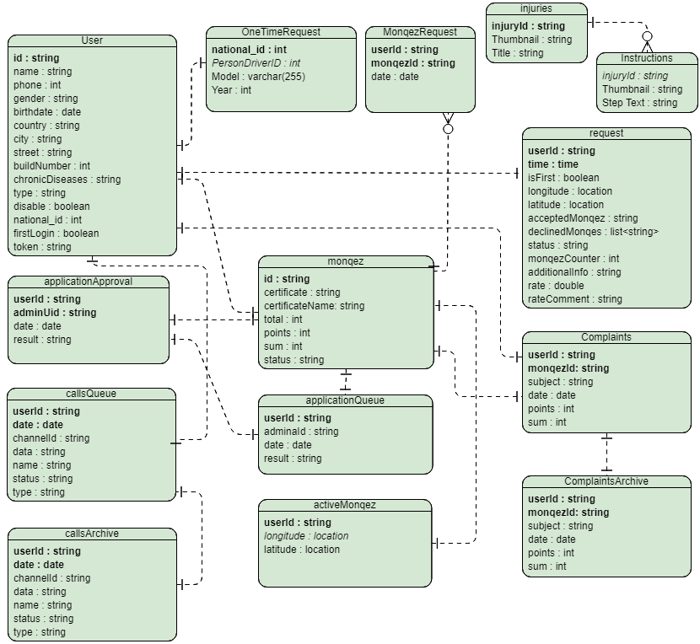
Entity Relationship Diagram (ERD)

Slide 32
07
Implementation & Testing

Slide 33
Implementation
Two levels of authentication used in “sign up”:
Firebase Authentication.
User’s additional information inserted in the database.
Two levels of authentication used in “sign in”:
Firebase Authentication.
Retrieve the type of the user and other helpful information from the database.
Voice and video calls were implemented using Agora SDK where our server generates the channel ID for each call.
Notes:
We used two levels of authentication, this done in “sign up”. The first level of authentication is creating the user’s account in the Firebase Authentication where we take the user’s email and password. The second level is where we take all the user’s additional information and insert it in the real-time database.
We used two levels of authentication in “sign in”. The first level is authenticating the user credential used Firebase Authentication to get access token and the second one is retrieving the type of the user from the real-time database.
Voice and video calls were implemented using Agora SDK. The normal user requests to make a call in which the server places the channel id in the call queue which is used to open a channel using Agora. Helper selects a call request from the call queue to get the channel id to join the same channel as the user.

Slide 34
Implementation
The chatbot was built using Dialogflow platform to increase the application’s usability. We provided the platform with our training phrases in both the entities and intents.
A session is opened between the user and the chatbot where every response on a user’s query is checked to see if there is an action that should be made or not.
If an action exists, the response is parsed to know the required action and then makes the action.
Notes:
Some entities were identified by machine learning, synonyms, and fuzzy matching such as the type of call, while others were identified using regular expressions such as the additional information entity.

Slide 35
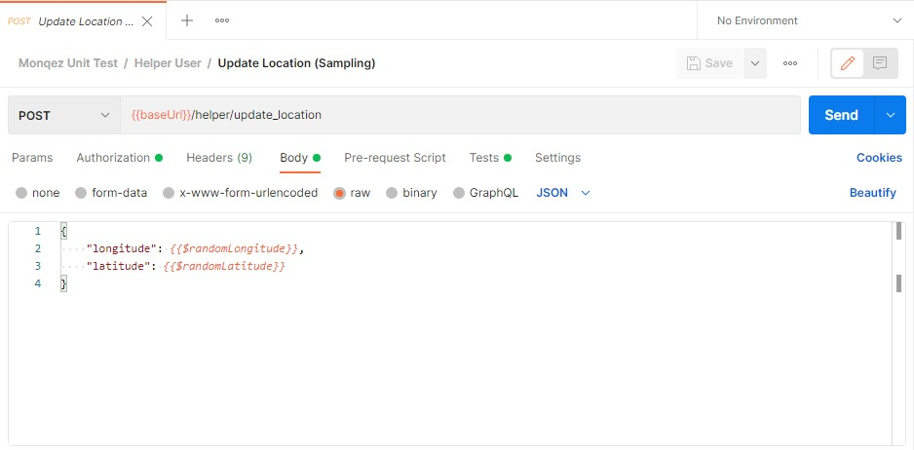
Testing
Update Location Unit Test Input

Slide 36
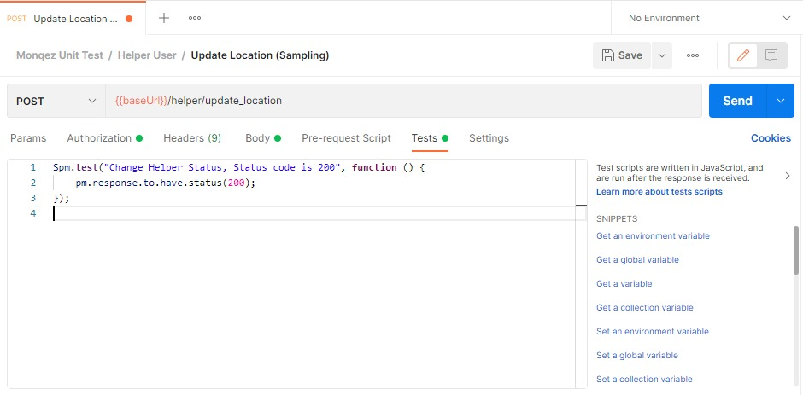
Testing
Update Location Unit Test Expected Return Value

Slide 37
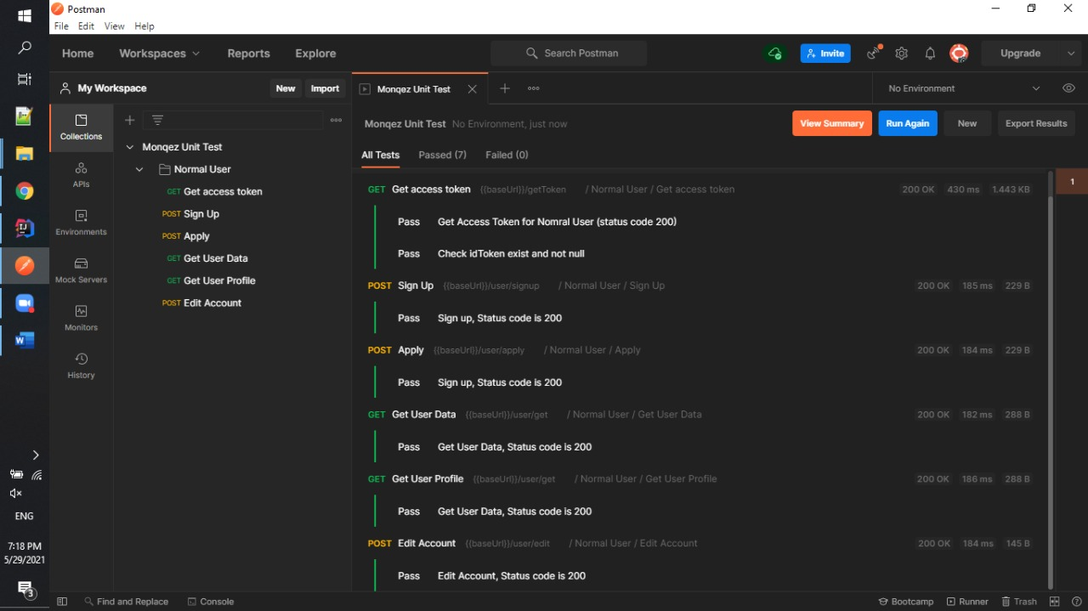
Testing
Unit Tests Summary

Slide 38
Conclusion
Monqez is a mobile application developed to help people in need of first aid.
It is expected to decrease the number of fatalities that occur before ambulances arrive.
It helps save lives by providing the appropriate first aid to the person in need of medical assistance in timely matter.
Its support to voice and video call will ensure that anyone near the victim can help him as much as possible until a paramedic arrives.
The presence of a chatbot in the application makes the application more useable and easier to use.
With minor modifications, the scope of Monqez can be completely changed.

Slide 39
Future Work
Notify the users whenever they are in an accident-prone zone using machine learning so that they would be careful.
Image processing could be used to automatically verify Monqez’s first-aid certificate and national ID images.
Implement a social network where friends and family can be notified in case of any harm happens to the user.

Slide 40

Monqez Demo

Slide 41
Monqez Demo

Slide 42
Thanks
Questions?

Slide 43
References
The Guardian. 2021. Lack of first aid skills endangers up to 150,000 lives.
University of Manchester. 2016. Over half of deaths from injury.
Redcross.org.nz. 2021. First aid courses | New Zealand Red Cross.
PulsePoint Respond.
Asifny (Google Play).
[Link]
[Link]
[Link]
[Link]
[Link]

Slide 44
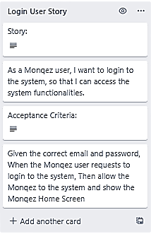
User Story Sample

